Slide 1
HIPAA Compliance Through AI: Workflow vs Agent Approaches for EHR Audit Trails
Ramkumar J
Senior Engineer

Slide 2
Agenda
Problem Statement & Business Context
Current State Analysis
Workflow Approach Design
Agent Approach Design
Comparative Analysis
Implementation Recommendations
Conclusion & Future Work

Slide 3
Problem Statement
Multi-tenant EHR application serving multiple clinics
ZERO audit trail mechanism currently
HIPAA compliance gap = $50K-$1.5M fine risk
Need: Intelligent audit system for 10,000+ daily events
Question: Workflow vs Agent - which approach is optimal?

Slide 4
Why Audit Trail System?
Real business need in my current project
Clear workflow vs agent comparison opportunity
HIPAA compliance requirements well-defined
Measurable outcomes (cost, performance, compliance)
Perfect for demonstrating practical AI implementation

Slide 5
Workflow Approach
CHAPTER ONE
Detailed Steps

Slide 6
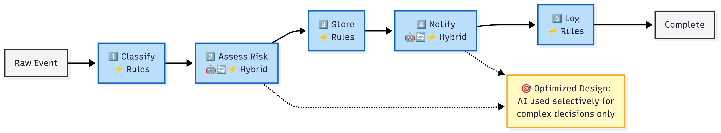
Audit Trail Workflow: Optimized AI + Rules Hybrid Approach

Slide 7
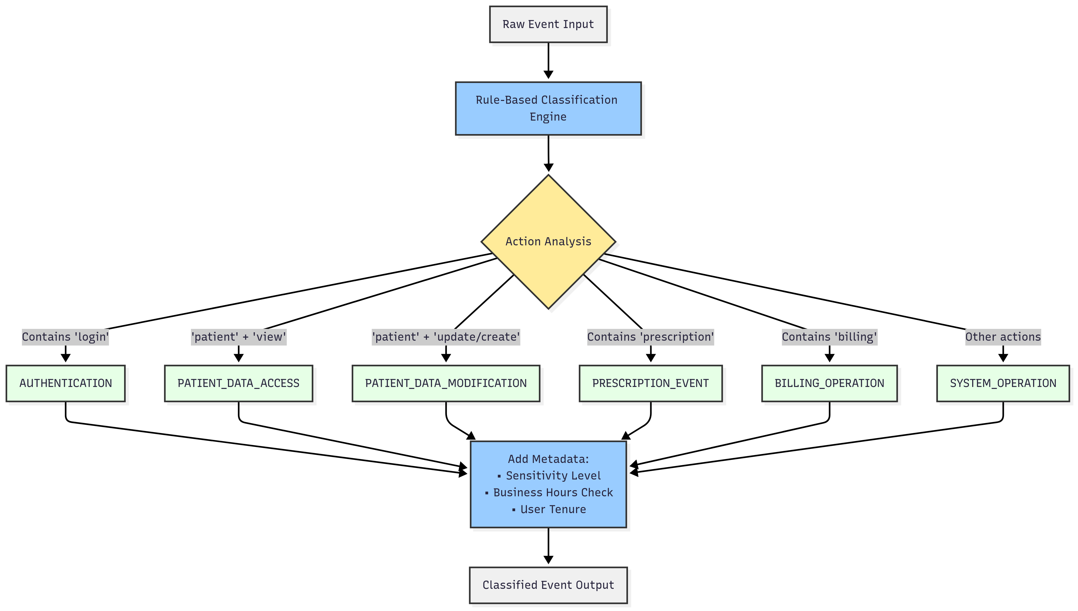
Step 1: Rule-Based Classification

Slide 8
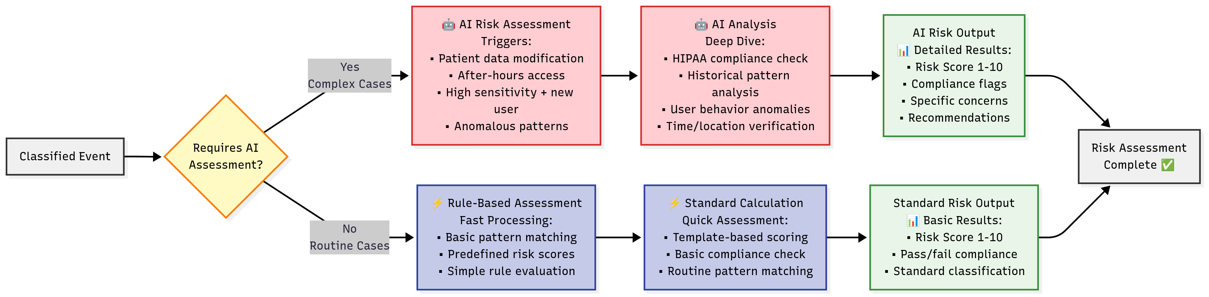
Step 2: Risk Assessment

Slide 9
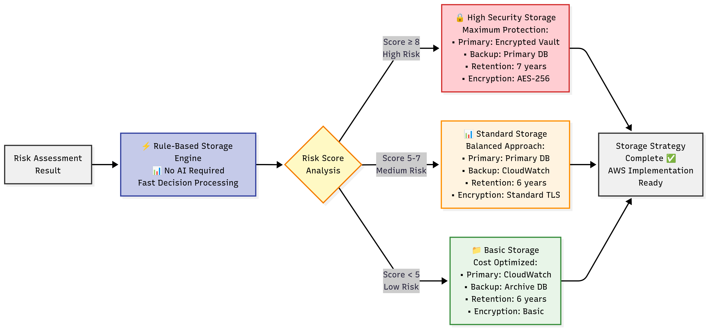
Step 3: Storage Decision (Rules Only)

Slide 10
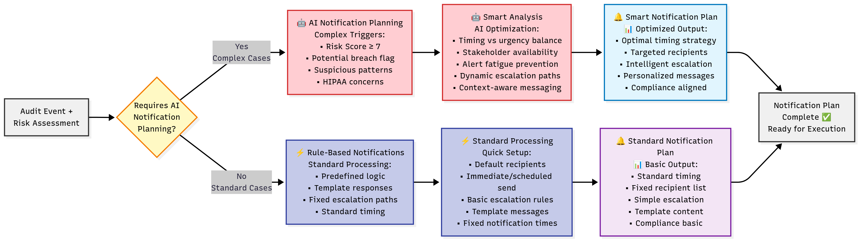
Step 4: Notification Strategy (AI + Rules)

Slide 11
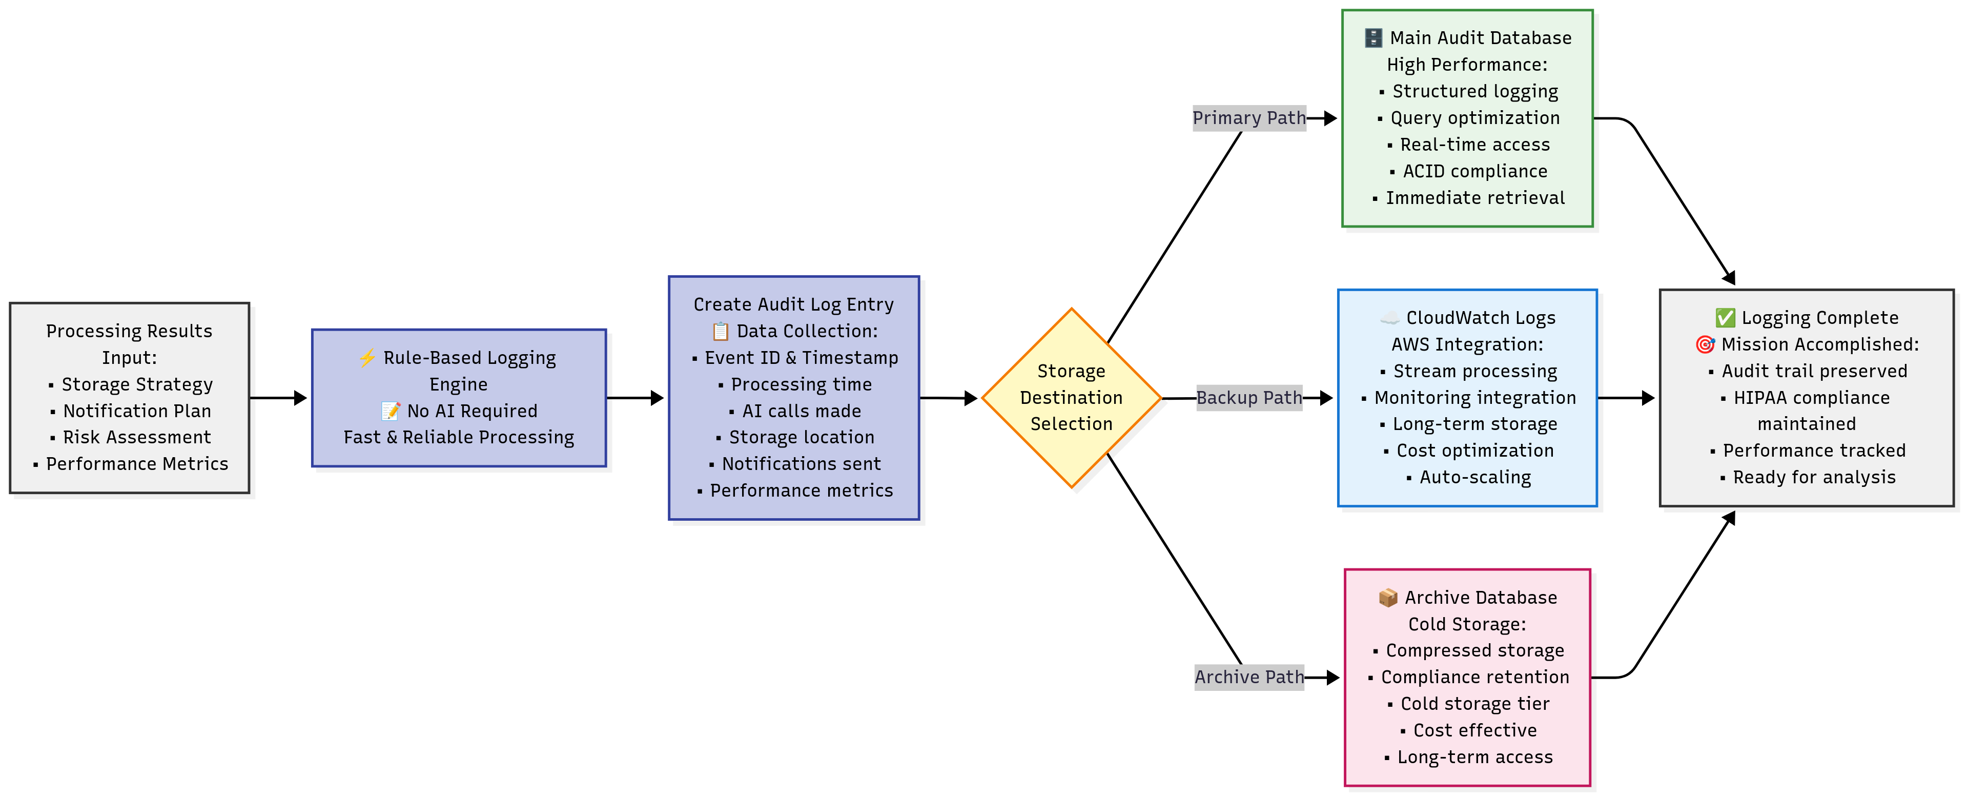
Step 5: Audit Logging (Rules Only)

Slide 12
When AI is used in Workflow
AI Usage: Strategic & Conditional
Risk Assessment: Only for high-risk events (20% of cases)
Notification Planning: Only for critical incidents (10% of cases)
Result: 0.3 AI calls per event average
Cost: $30/day for 10,000 events

Slide 13
Agent Approach
CHAPTER TWO
Detailed Steps

Slide 14
Agent Architecture Overview

Slide 15
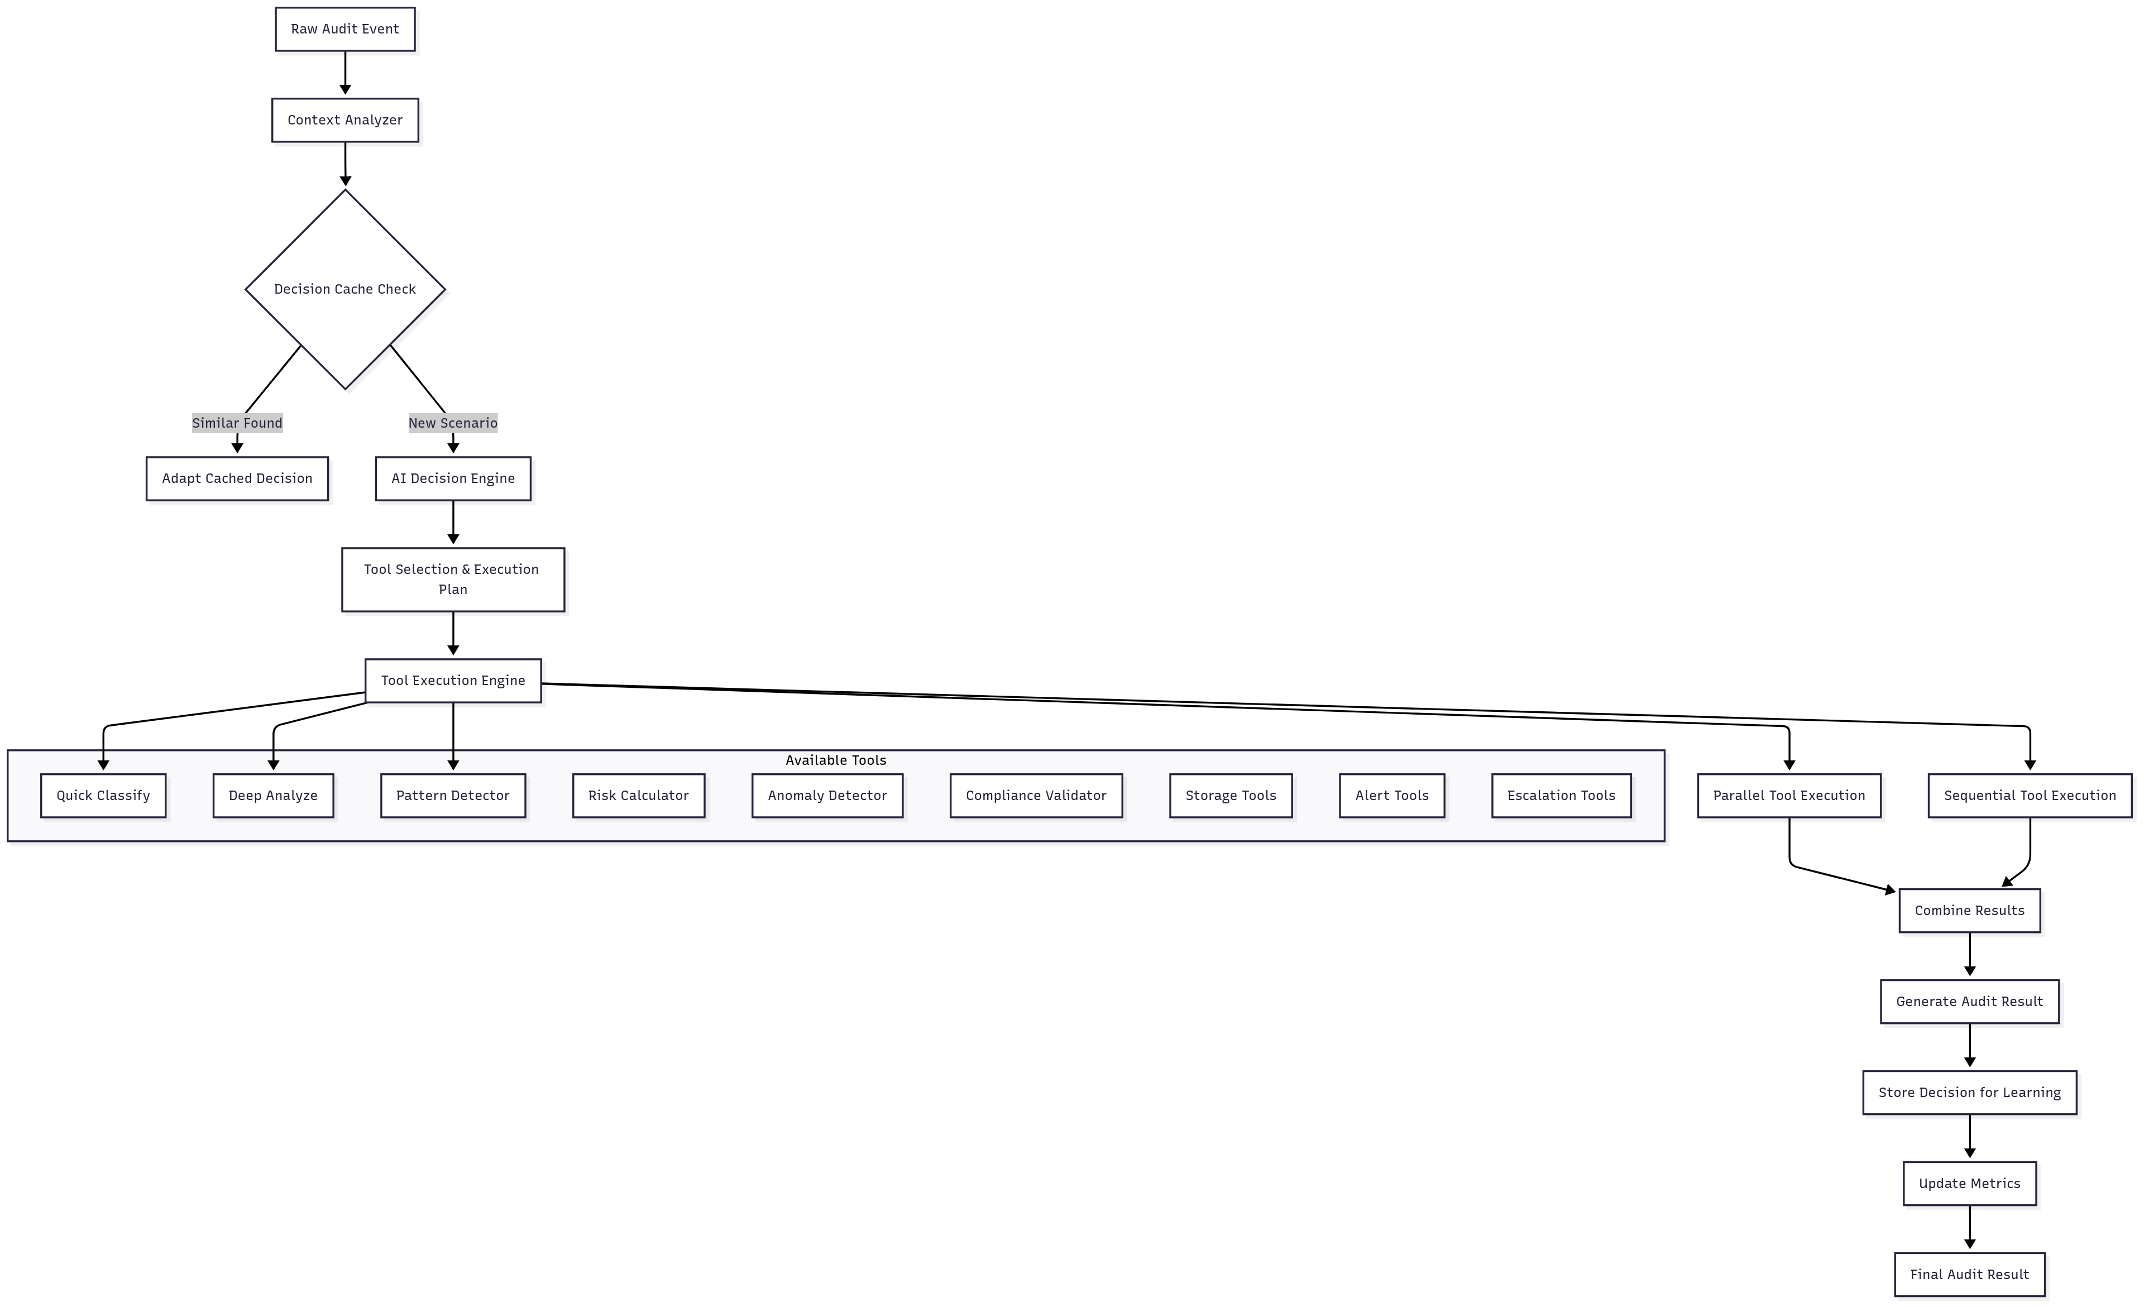

Slide 16
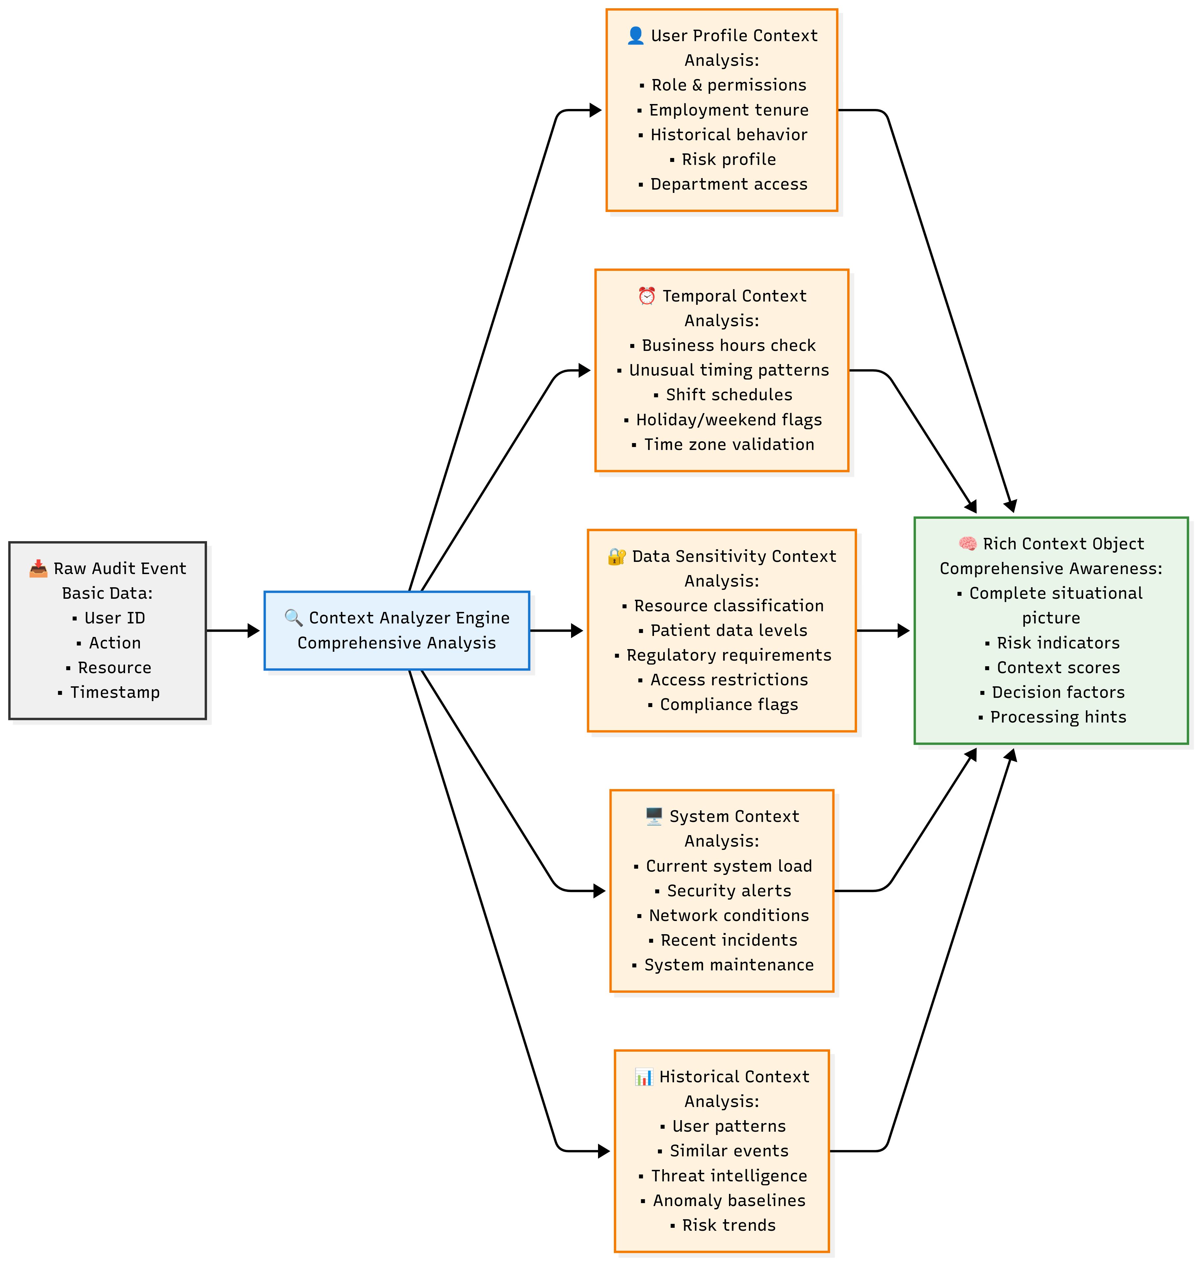
Step 1: Context Analysis & Event Capture

Slide 17
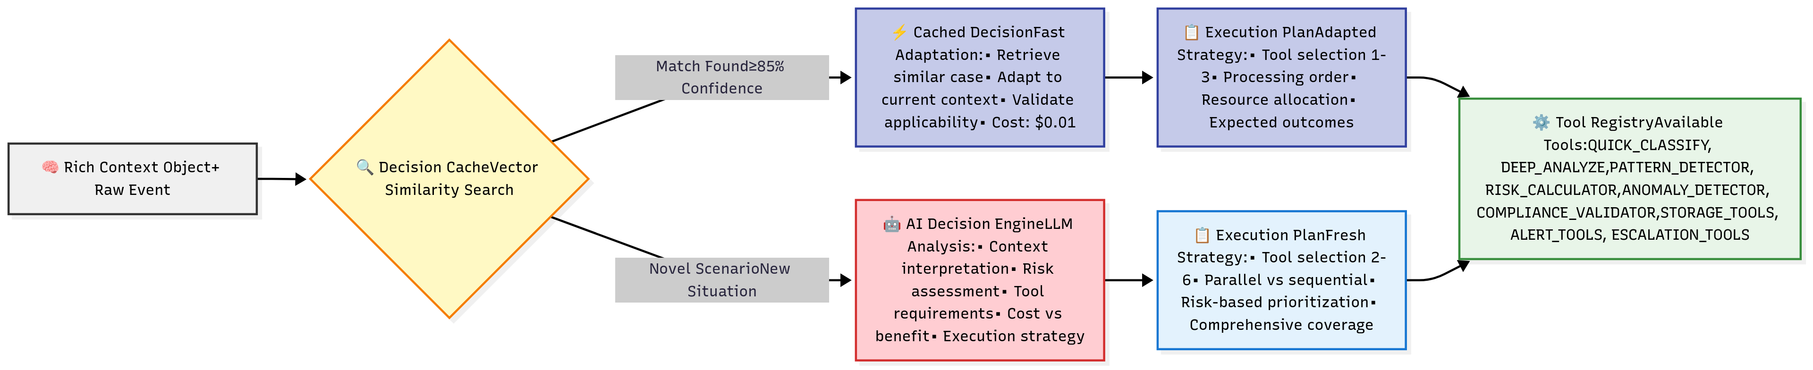
Step 2: AI Decision Engine & Tool Selection

Slide 18
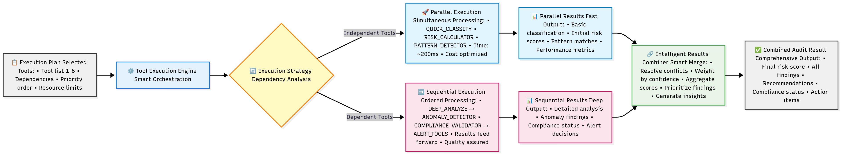
Step 3: Smart Tool Execution Engine

Slide 19
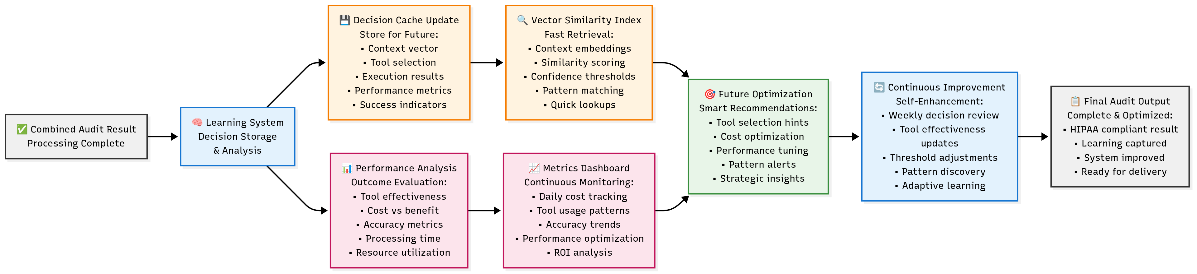
Step 4: Learning & Adaptation System

Slide 20
Agent Decision Logic
AI analyzes event context
Dynamically selects 1-6 tools
Execution path varies per event
1.0 AI call per event (always)
Cost: $100+/day for 10,000 events

Slide 21
Agent Strengths & Weaknesses
✅ Strengths:
Adaptive to novel scenarios
Advanced pattern recognition
Self-improving over time
Contextual intelligence
❌ Weaknesses:
Unpredictable costs
Variable compliance depth
Complex debugging
AI service dependency

Slide 22
Comparative Analysis
Evaluation Criteria | AI-Enhanced Workflow | Dynamic AI Agent | Winner | Impact Level
Performance
Average Response Time | 150ms (mostly rules) | 800ms (AI + tools) | Workflow | HIGH
AI Calls per Event | 0.3 (conditional) | 1.0 (always) | Workflow | HIGH
Throughput (events/sec) | 1,000+ | 200-300 | Workflow | HIGH
Cost Analysis
Daily Cost (10K events) | $30 | $100+ | Workflow | CRITICAL
Monthly Cost | $900 | $3,000+ | Workflow | CRITICAL
Cost Predictability | Fixed | Variable | Workflow | HIGH

Slide 23
Comparative Analysis
Evaluation Criteria | AI-Enhanced Workflow | Dynamic AI Agent | Winner | Impact Level
Compliance & Audit
Audit Trail Consistency | 100% complete | Variable depth | Workflow | CRITICAL
Regulatory Acceptance | Predictable process | AI "black box" | Workflow | CRITICAL
HIPAA Documentation | Standard format | Variable format | Workflow | HIGH
Intelligence & Adaptability
Novel Threat Detection | Rule-based only | Pattern recognition | Agent | MEDIUM
Self-Learning Capability | Manual updates | Automatic improvement | Agent | MEDIUM
Context Awareness | Limited | Comprehensive | Agent | HIGH

Slide 24
Comparative Analysis
Evaluation Criteria | AI-Enhanced Workflow | Dynamic AI Agent | Winner | Impact Level
Operational
Debugging Complexity | Clear step trace | Complex decision paths | Workflow | HIGH
Maintenance Overhead | Rule updates needed | Self-maintaining | Agent | MEDIUM
System Dependencies | Minimal | AI service critical | Workflow | HIGH
Scalability
Horizontal Scaling | Linear scaling | AI bottleneck | Workflow | HIGH
Resource Utilization | Predictable | Variable spikes | Workflow | MEDIUM

Slide 25
Detailed Cost Analysis (per 10000 requests)
Cost Component | AI Workflow | Dynamic Agent | Difference
AI Processing
Event Classification | $0 (rules) | $100 (10K × $0.01) | +$100
Risk Assessment | $20 (2K events × $0.01) | Included above | -$20
Storage Decisions | $0 (rules) | Included above | $0
Notification Planning | $10 (1K events × $0.01) | Included above | -$10
Tool Execution | $0 (rules) | $50 (variable tools) | +$50
Infrastructure
Database Operations | $5 | $8 | +$3
Cloud Storage | $3 | $5 | +$2
Monitoring/Logging | $2 | $4 | +$2
TOTAL DAILY | $30 | $167 | +$137

Slide 26
Use Case Decision Matrix
Use Workflows When:
Scenario | Why Workflow Wins | Risk of Using Agent
Large Hospital System | • 50K+ daily events • Predictable $450/month cost • Clear audit trail for inspectors | • $2,500+/month variable cost • Unpredictable AI decisions • Regulatory compliance questions
Multi-Clinic EHR | • HIPAA compliance critical • Budget constraints • Standard audit requirements | • 5x higher costs • Complex debugging • AI "black box" concerns
Insurance Claims Processing | • High-volume routine events • Consistent processing needed • Cost optimization priority | • Variable processing depth • Unpredictable response times • Regulatory scrutiny

Slide 27
Use Case Decision Matrix
Use Agents When:
Scenario | Why Agent Wins | Risk of Using Workflow
Cybersecurity SOC | • Advanced threat detection<br>• Pattern recognition crucial<br>• Context-aware responses | • Rule-based limitations<br>• Manual threat signature updates<br>• Missing novel attack patterns
Financial Fraud Detection | • Complex transaction patterns<br>• Adaptive criminal behavior<br>• Real-time intelligence needed | • Static rule limitations<br>• High false positive rates<br>• Delayed threat response
Research Hospital | • Experimental data access patterns<br>• Complex user roles<br>• Innovation-friendly environment | • Limited pattern recognition<br>• Rigid compliance interpretation<br>• Research workflow constraints

Slide 28
Risk Assessment Matrix
Risk Category | Workflow Risk | Agent Risk | Mitigation Strategy
Compliance Failure | LOW - Predictable audit trail | MEDIUM - Variable documentation | • Hybrid approach for critical events • Agent reasoning logging
Cost Overrun | LOW - Fixed costs | HIGH - Variable AI usage | • Budget caps on AI calls • Circuit breaker patterns
Performance Issues | LOW - Rule-based speed | MEDIUM - AI latency | • Async processing • Tool optimization
Security Gaps | MEDIUM - Rule limitations | LOW - Adaptive detection | • Regular rule updates • Human expert backup
Technical Debt | MEDIUM - Rule maintenance | LOW - Self-improving | • Automated rule generation • Version control

Slide 29

Thank You
Ramkumar J
Senior Engineer, Presidio
ramkumarj@presidio.com

